Slide 1

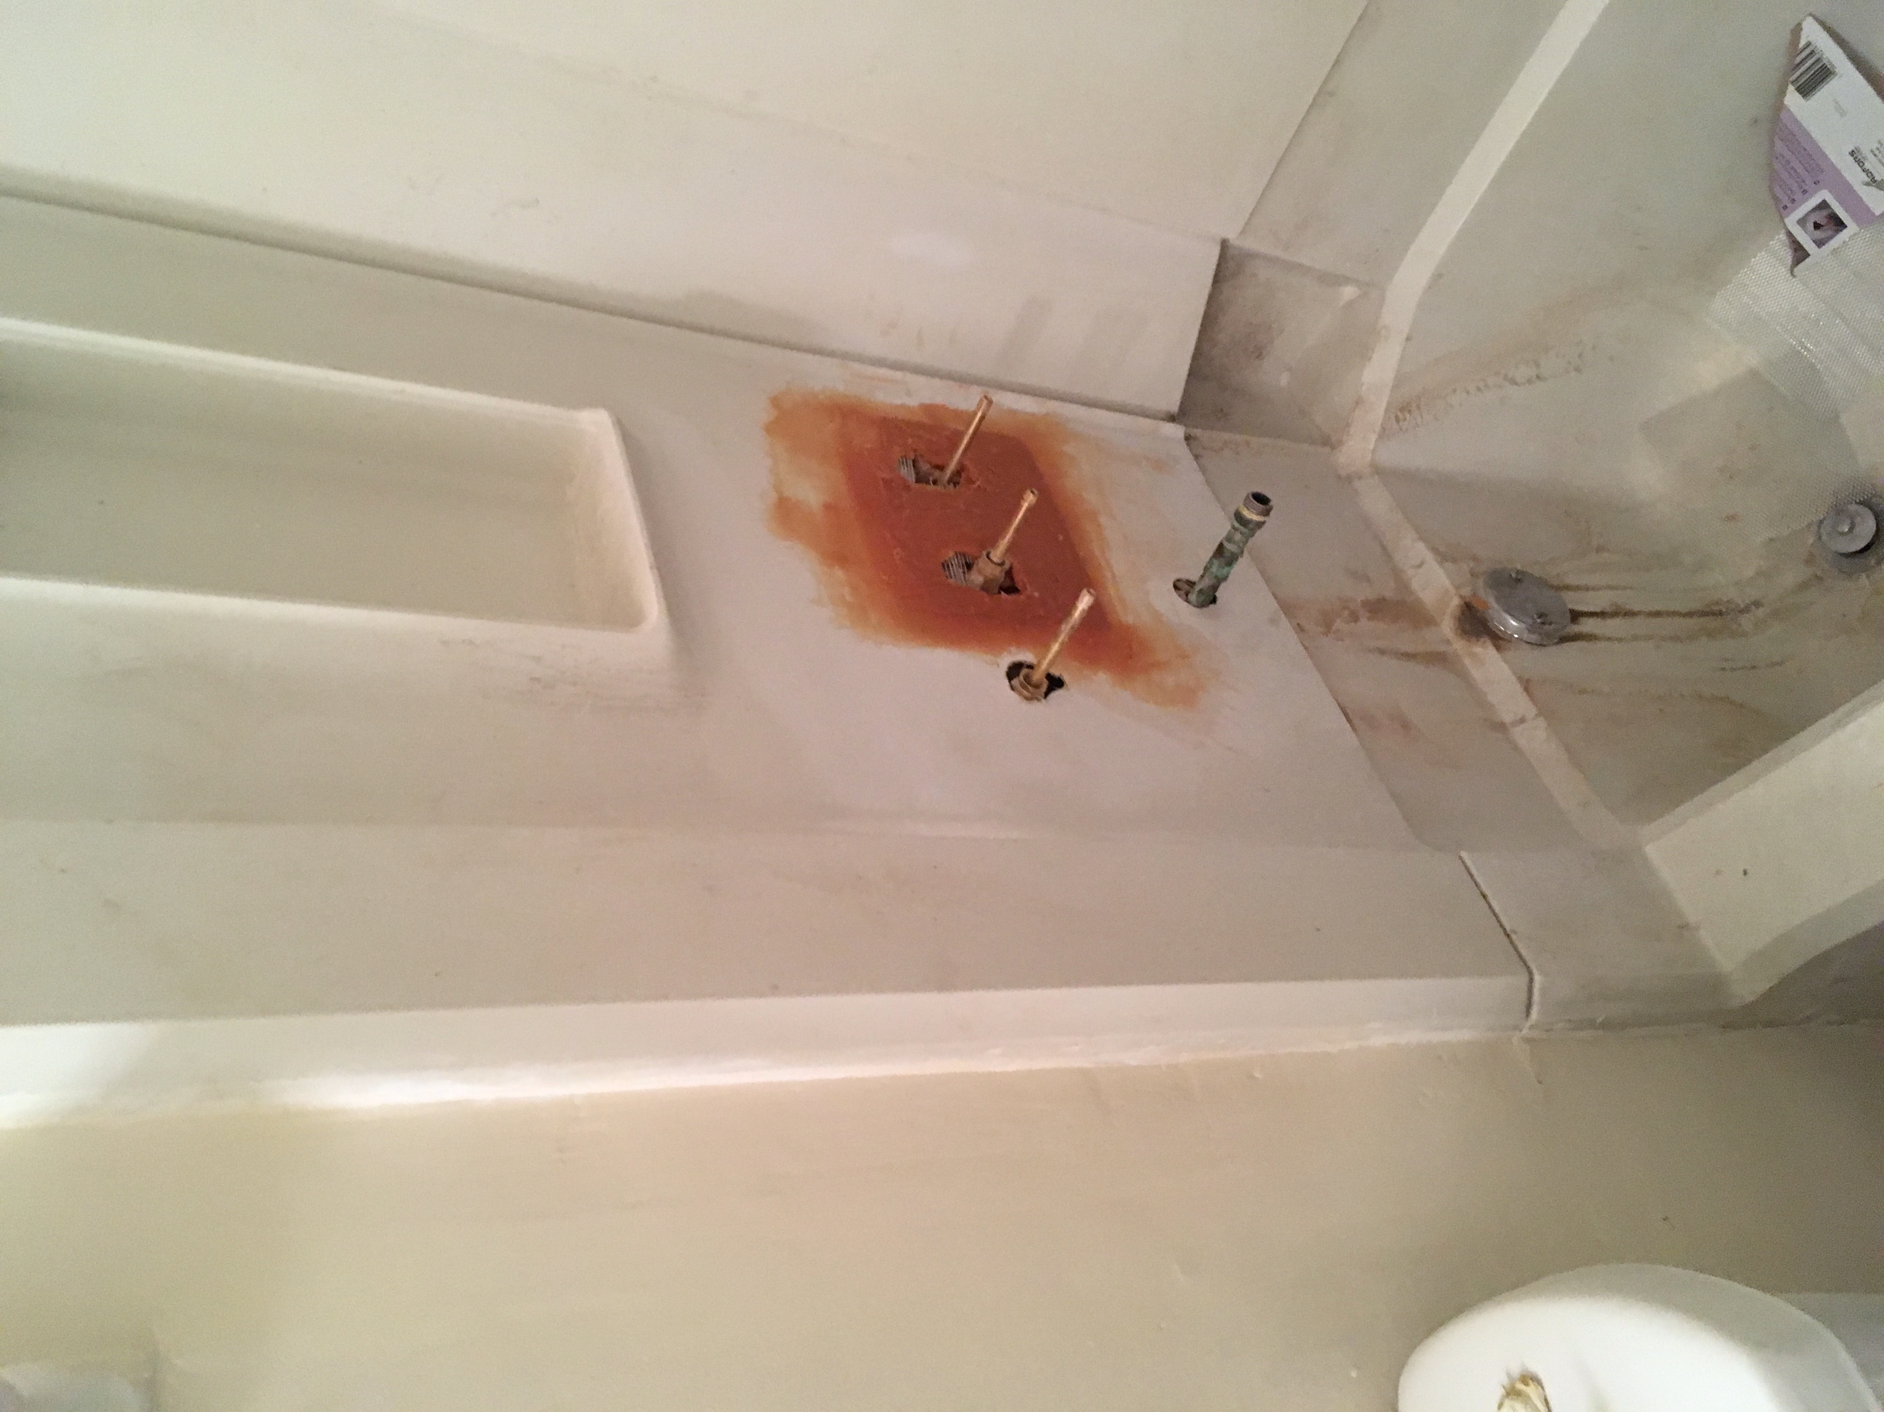
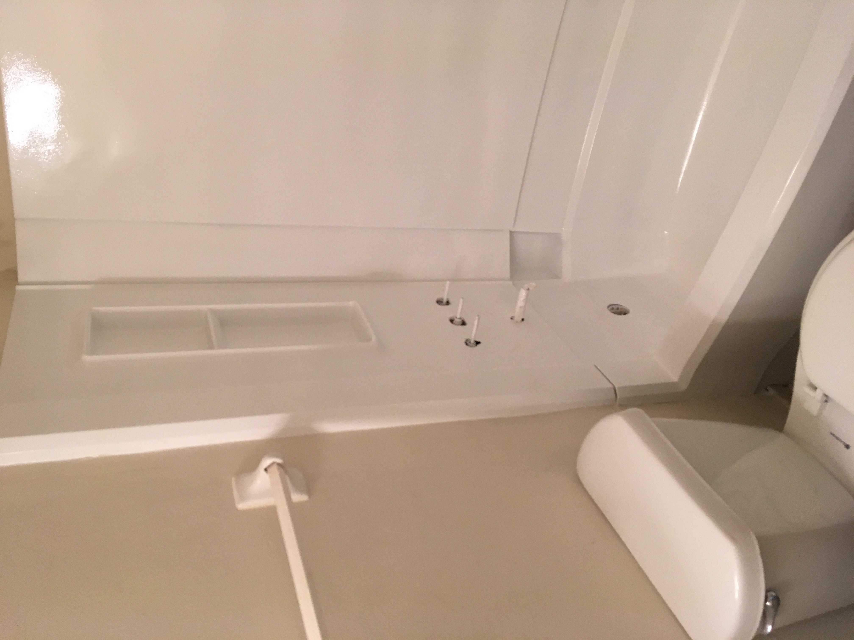
Services
Move In/Out Cleaning
Bathtub / Counter top Refinishing
Commercial Cleaning
Vacation Rentals Cleaning
Pressure Washing
Floor Strip/Polishing
Lawn Care
LICENSED and INSURED!!
AFFORDABLE PRICES!!
BEFORE
AFTER
CALL TODAY!!!
(850) 529-5367
“ IT’S NOT CLEAN IF IT DONT SPARKLE!!!”
EMAIL: sparklecleaningservices227@gmail.com

Slide 2
Sparkle Cleaning Solutions LLC Email:sparklecleaningservices227@gmail.com Phone: (850) 529-5367
Base Price Sheet
Apartment Deep Cleaning
Studio - $70.00
1 bedroom- $90.00
2 bedrooms- $115.00
3 bedrooms-$135.00
*There is an additional ($15.00) charge for a 3rd bath.
Move In/Out Cleaning
1 bedroom:$110.00-$140.00
2 bedrooms:$150.00-$165.00
3 bedroom:$170.00-$195.00
4 bedroom:200.00-$225.00
*Prices may vary depending on the condition of the home.
Vacation Rental Cleaning
1 bedroom: $90.00
2 bedrooms: $120.00
3 bedrooms: $140.00
4 bedrooms: $160.00
(FREE Estimates for the Following services)
Other Services
Pressure Washing
Floor strip/polishing
Carpet Cleaning
Lawn Services

